Slide 1
COMP 76 – Design Principles and Guidelines
Fall 2023 – Week 9

Slide 2
AGENDA
Questions
Recap
Design Principles

Slide 3
Recap
Empathy
What are the users experiencing
Personas
Who are we empathizing with?
User Stories
What are they trying to do, specifically
User Journey
What steps do they take to accomplish their goal
Ideation
Narrow down the problem, think about solutions
User Flows
Plan each step in the journey and how to connect them

Slide 4
Recap
Ideation
Narrow down the problem, think about solutions
User Flows
Plan each step in the journey and how to connect them
Wireframes
Get the concept created and approved

Slide 5
Design Principles
How will users interact with the design

Slide 6
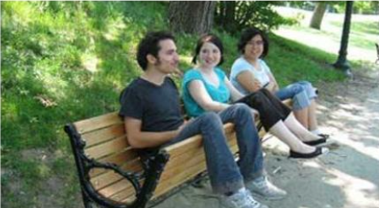
What’s wrong with this?

Slide 7

What’s wrong with this?

Slide 8

What’s wrong with this?

Slide 9

Who?
Don Norman (Norman Doors)
User Centered Design
Fundamental Models of how people interact with design

Slide 10
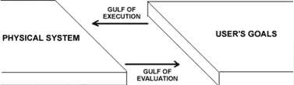

Two Actions at Work
Where do I Press?
How do I do this?
Copy and Paste Text
http://learnline.cdu.edu.au/units/hit381/resources/popups/normantheoryofaction.html

Slide 11
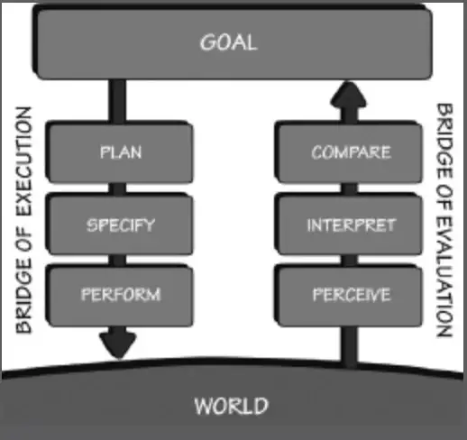
Seven Stages of Action
Everyday Things – Don Norman

Slide 12
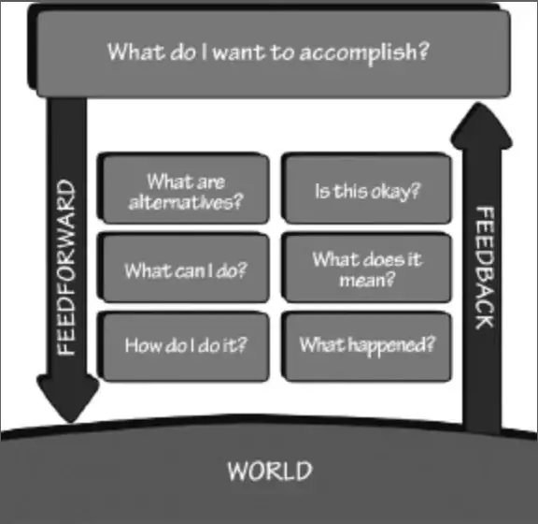
Seven Stages of Action
Everyday Things – Don Norman

Slide 13
Stages of Action...In Action
Goal: Get more light to read at dusk
Action needed: Turn on the lamp (Smart light at dusk)
Specify how to turn on the light
Take the action to turn it on
Perceive if there is enough light in the room
Decide if the lamp is turned on
Decide if there is enough light to read

Slide 14
User Challenges
User needs to understand the interface well enough to be able create or follow a task sequence (flow)
Feedback to the user needs to be clear enough to allow users to interpret the current state and use it to compare to their goal

Slide 15
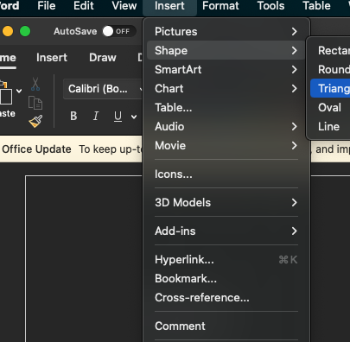
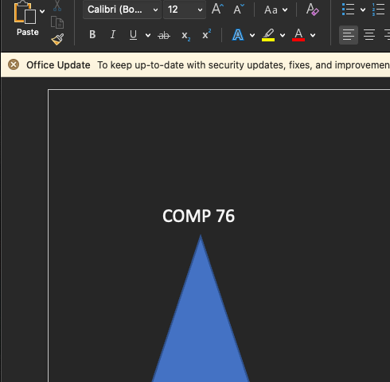
User Challenges - Example
Goal: Insert a Shape
Feedback: The shape appears

Slide 16
Normans Models
From Mental Model to
Conceptual Model

Slide 17
The Mental Model
How the user understands the operation of the system. The mental model is usually much more straightforward than reality (eg: Accelerator pedal makes car move)
User uses this to predict how the system will behave with input
If the model fails the user can predict gaps, inconsistencies or future behaviour

Slide 18
The Conceptual Model
Conceptual model is how the system actually works (eg: Press the brake and explain in detail how a disc brake works)
Offers a correct explanation or prediction of how the system operates
The designer is in fact developing this model

Slide 19
How They Work Together
User’s develop mental models through using system, training, talking with others, and through guesswork and superstition
Systems have conceptual models that explain how the system actually works and allow prediction of the system’s response to user inputs
A strong indicator of a system’s ease of use is how easily and accurately users develop mental models
People use their mental model to develop a correct action sequence represented by the seven stages of action

Slide 20
How to Reveal the Conceptual Model
Affordance
Metaphors
Spatial Mapping
Direct Manipulation

Slide 21
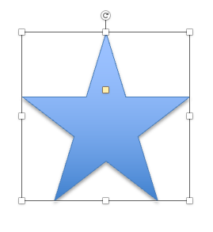
Affordance
Help the user know what to do without pictures, labels or instructions

Slide 22
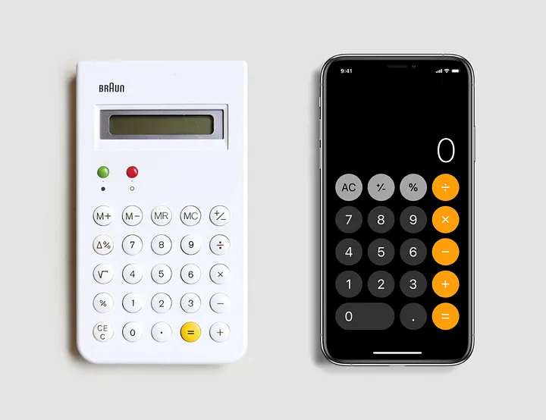
Metaphors
Creates a theme of how a design works. This creates an agreement between the designer's vision and what the user expects to happen

Slide 23

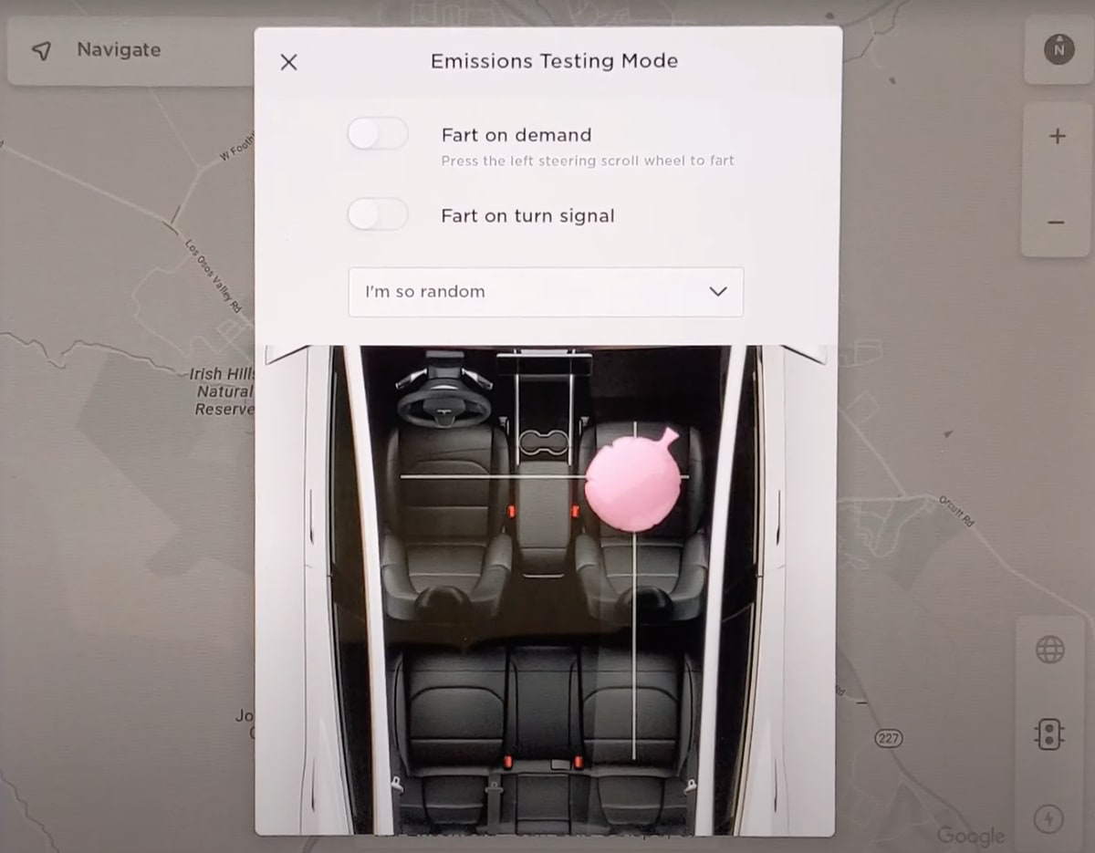
Spatial Mapping
Relate the design to the real-world mapping. Move the control to have an anticipated effect.

Slide 24
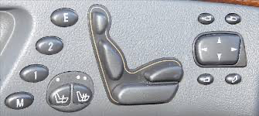
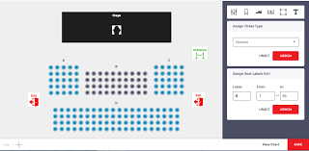
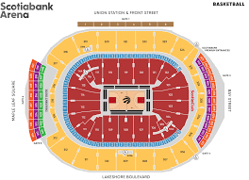
Direct Manipulation
Interaction with the exact on-screen visual through an interface. Representation of the object in question is continuous.

Slide 25
Design Guidelines
Here’s what we recommend…

Slide 26
10 Usability Heuristics
Visibility of System Status
Match Between System and Real World
User Control and Freedom
Consistency and Standards
Error Prevention
Recognition Over Recall
Flexibility and Efficiency
Aesthetic and Minimalist Design
Help Users Recover from Errors
Help and Documenation

Slide 27
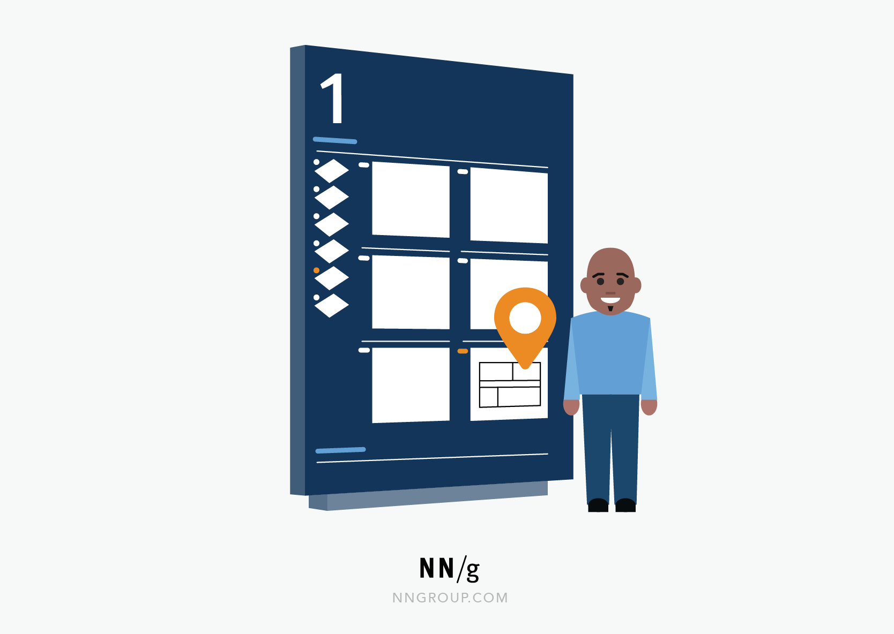
1. Visibility of System State
The design should always keep users informed about what is going on, through appropriate feedback within a reasonable amount of time.
Mall Maps

Slide 28
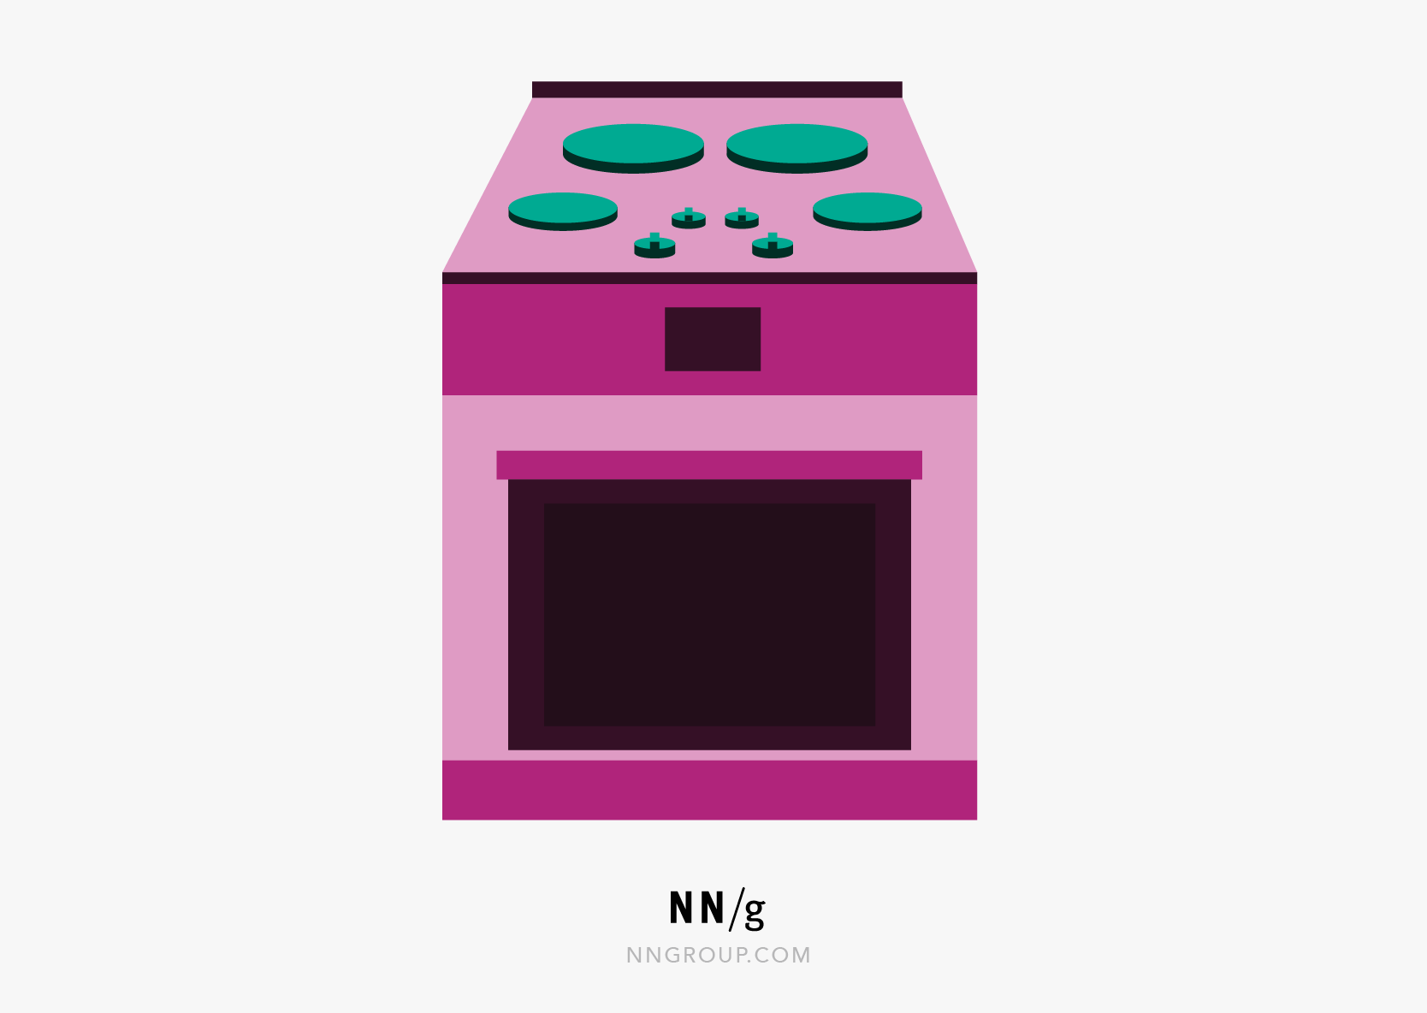
2. Match Between System and Real World
The design should speak the users' language. Use words, phrases, and concepts familiar to the user, rather than internal jargon. Follow real-world conventions, making information appear in a natural and logical order.
Stovetop Controls

Slide 29
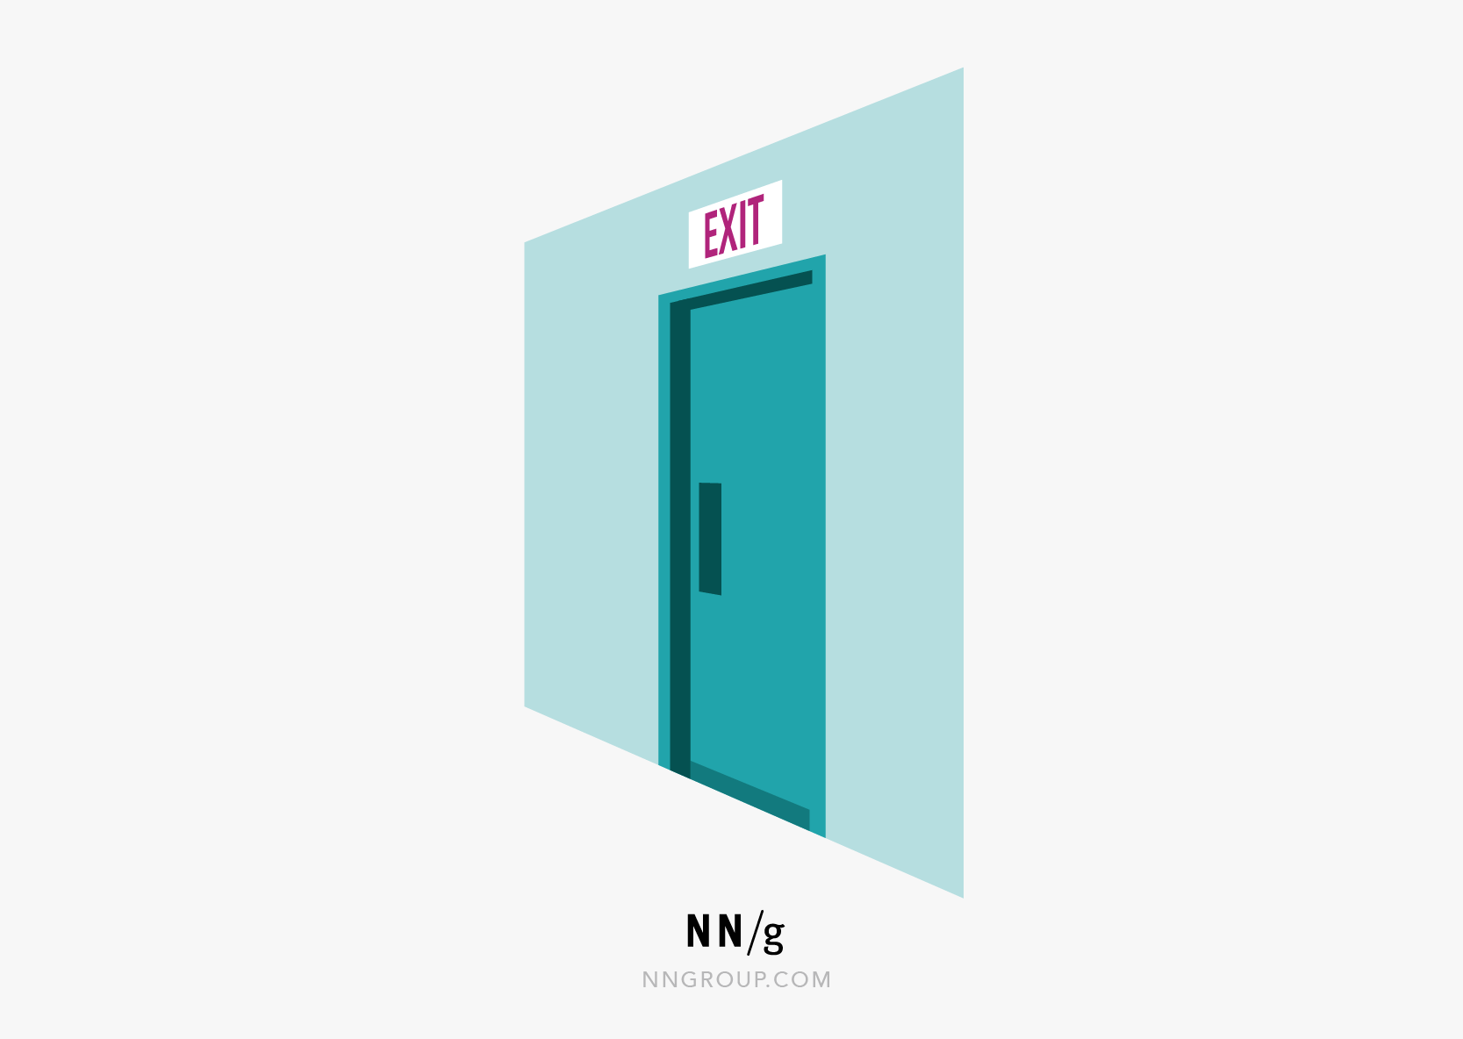
3. User Control and Freedom
Users often perform actions by mistake. They need a clearly marked "emergency exit" to leave the unwanted action without having to go through an extended process.
Emergency Exits

Slide 30
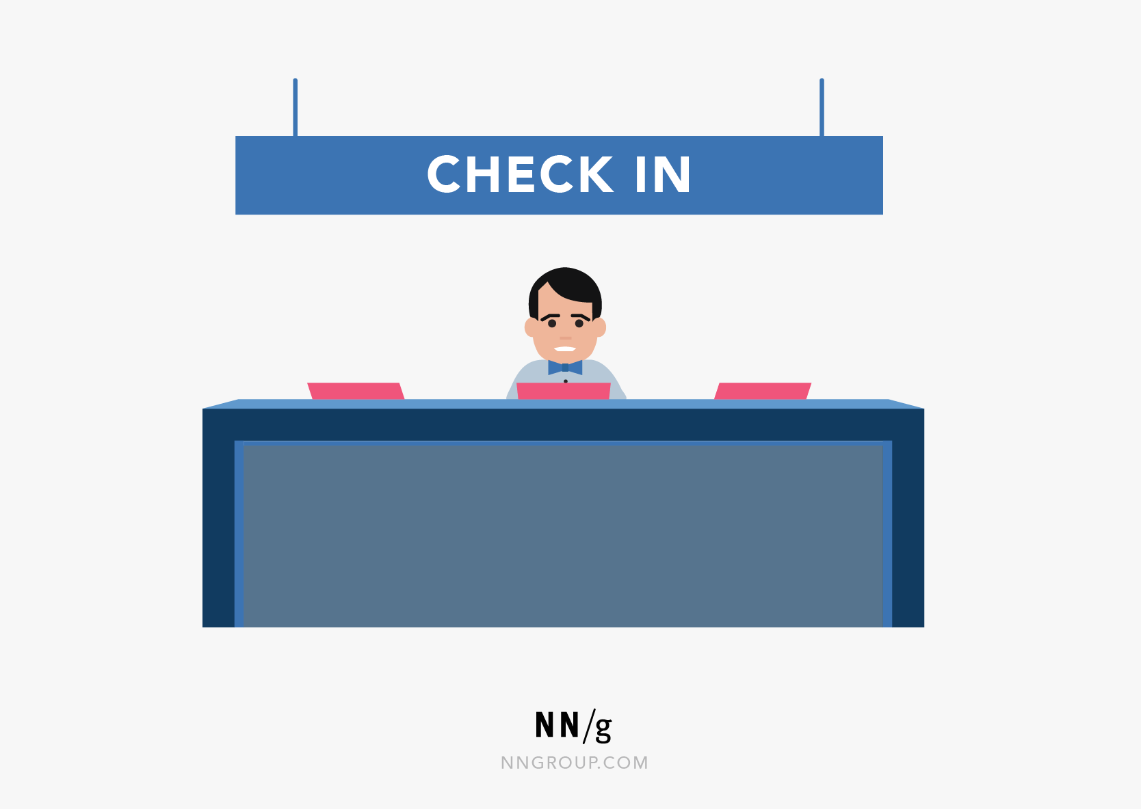
4. Consistency and Standards
Users should not wonder whether different words, situations, or actions mean the same thing.
Follow platform and industry conventions.
E.g.:
• Back returns to the previous screen
• Cancel exits operation
• Print is Cmd/Ctl-P

Slide 31
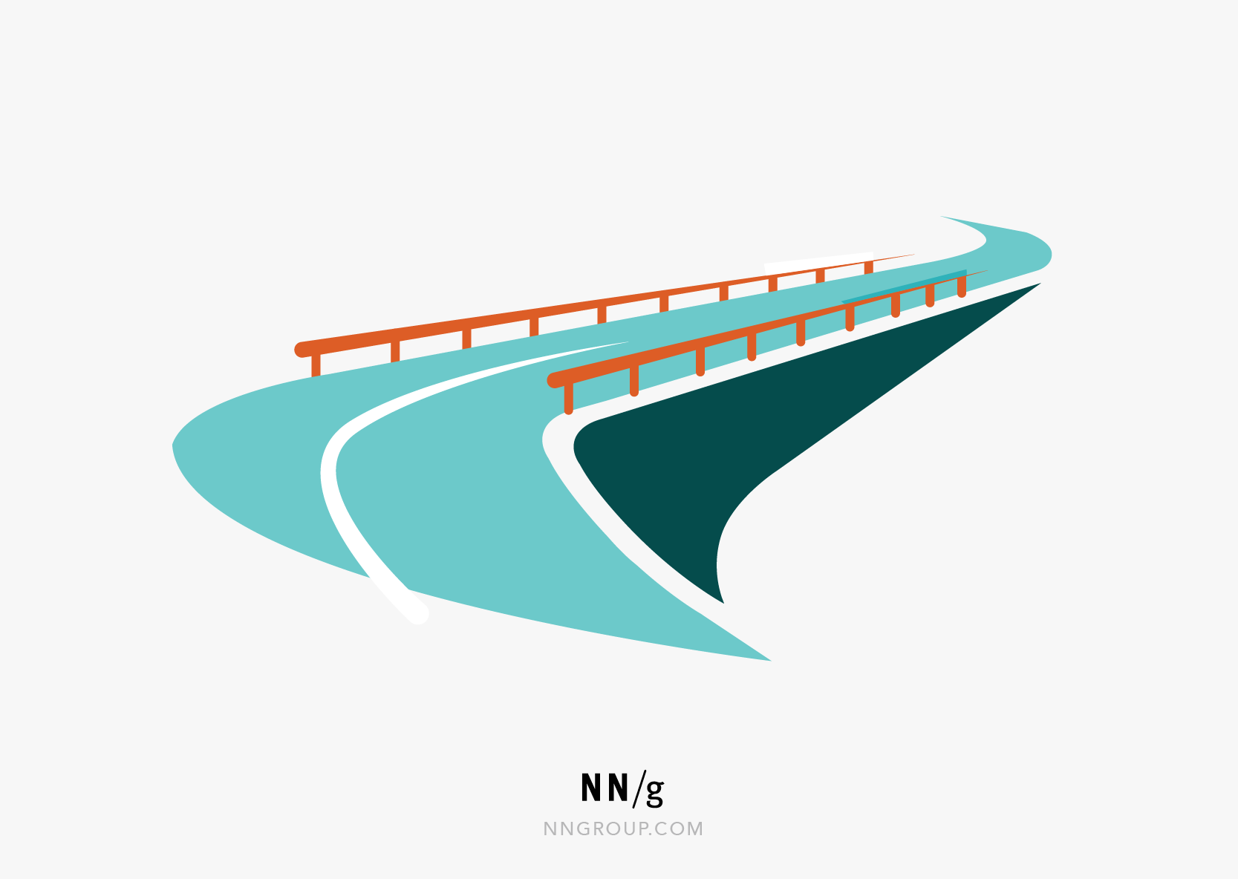
5. Error Prevention
Good error messages are important, but the best designs carefully prevent problems from occurring in the first place. Either eliminate error-prone conditions or check for them and present users with a confirmation option before they commit to the action.

Slide 32
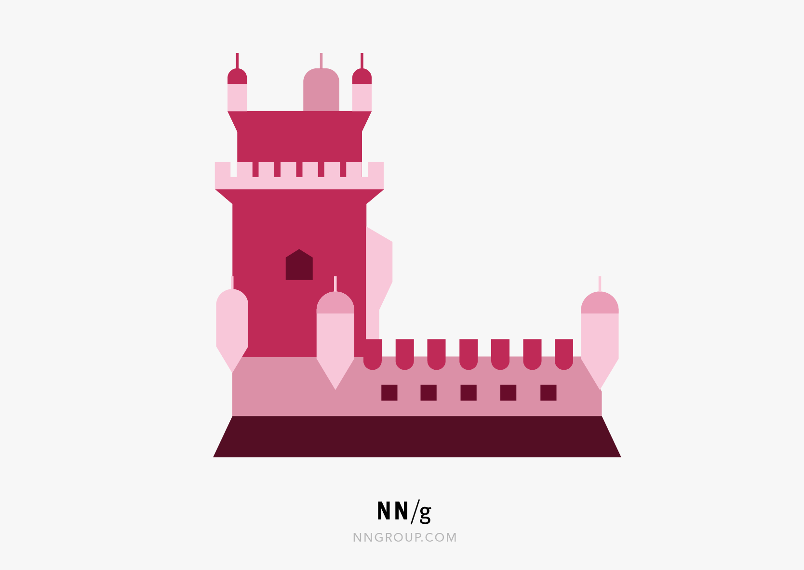
6. Recognition Over Recall
Minimize the user's memory load by making elements, actions, and options visible. The user should not have to remember information from one part of the interface to another. Information required to use the design (e.g. field labels or menu items) should be visible or easily retrievable when needed.

Slide 33
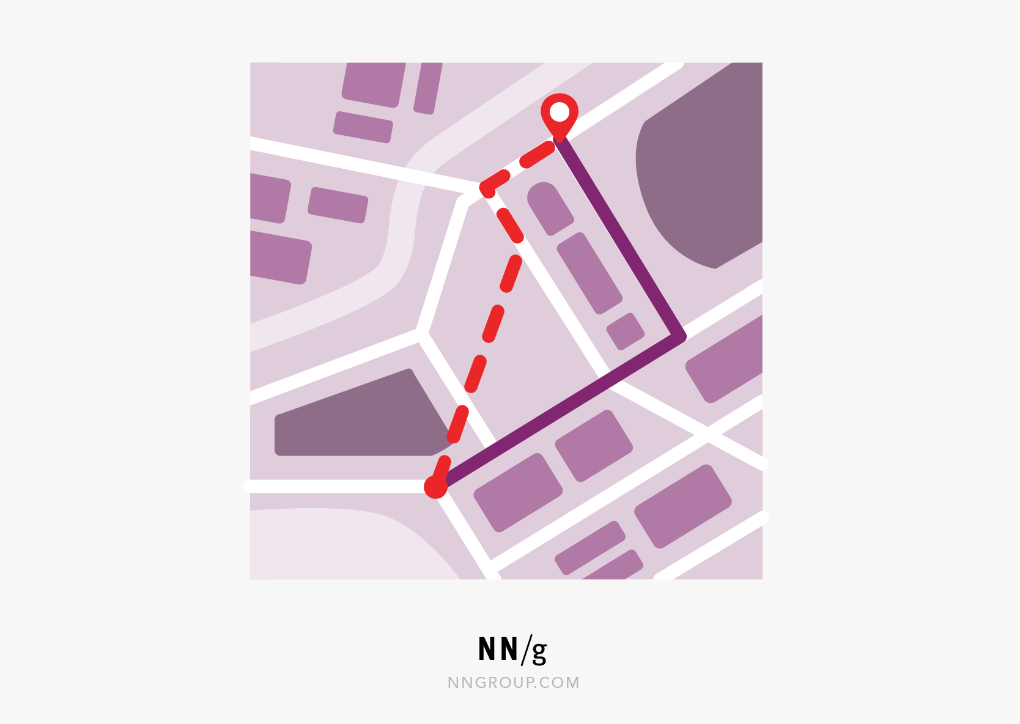
7. Flexibility and Efficiency
Shortcuts — hidden from novice users — may speed up the interaction for the expert user so that the design can cater to both inexperienced and experienced users. Allow users to tailor frequent actions.

Slide 34

8. Aesthetic and Minimalist Design
Interfaces should not contain information that is irrelevant or rarely needed. Every extra unit of information in an interface competes with the relevant units of information and diminishes their relative visibility.

Slide 35
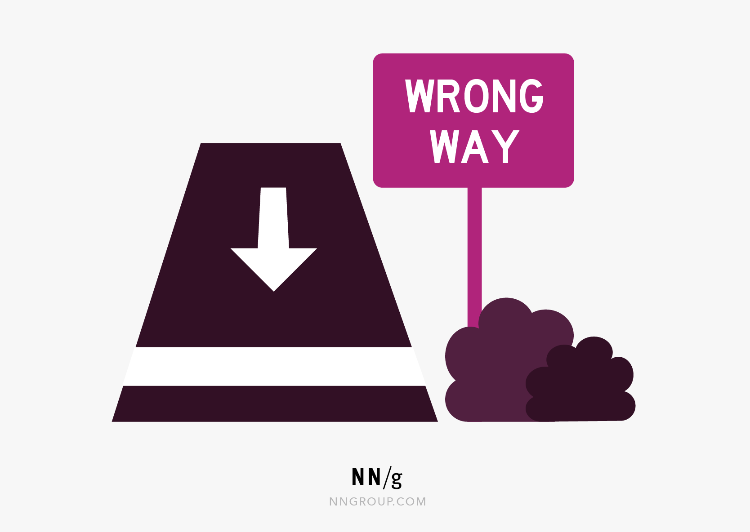
9. Help Users Recover from Errors
Error messages should be expressed in plain language (no error codes), precisely indicate the problem, and constructively suggest a solution. (Cancel and undo operations)

Slide 36
10. Help and Documentation
It’s best if the system doesn’t need any additional explanation. However, it may be necessary to provide documentation to help users understand how to complete their tasks.

Slide 37
Heuristics
Definition
A technique or mental shortcut that helps people make decisions more efficiently
Nobel winner Herbert Simon in the 50’s
Jakob Neilsen and Ralph Molich defined the technique based on an evaluation of 249. problems in 1990
Refined in 2020
This is the way!

